Slide 1
C# Fundamentals Day - 1
Hunaid Hussain

Slide 2
Topics
C# Vs .Net
CLR (Common Language Run-time)
Architecture of .Net Applications
Our First C# Application
Primitive Types
Variable and Constants
Identifiers
Naming Conventions
Integral Numbers
Real Numbers
Character
Boolean
Scope
Hands-On Demo

Slide 3
Continue..
Type Conversions
Demo: Type Conversions
Operators
What are logical operators?
Demo: Operators
Comments
Quiz 1: Fundamental of C# and .NET
Quiz 2: Primitive Type and Expressions

Slide 4
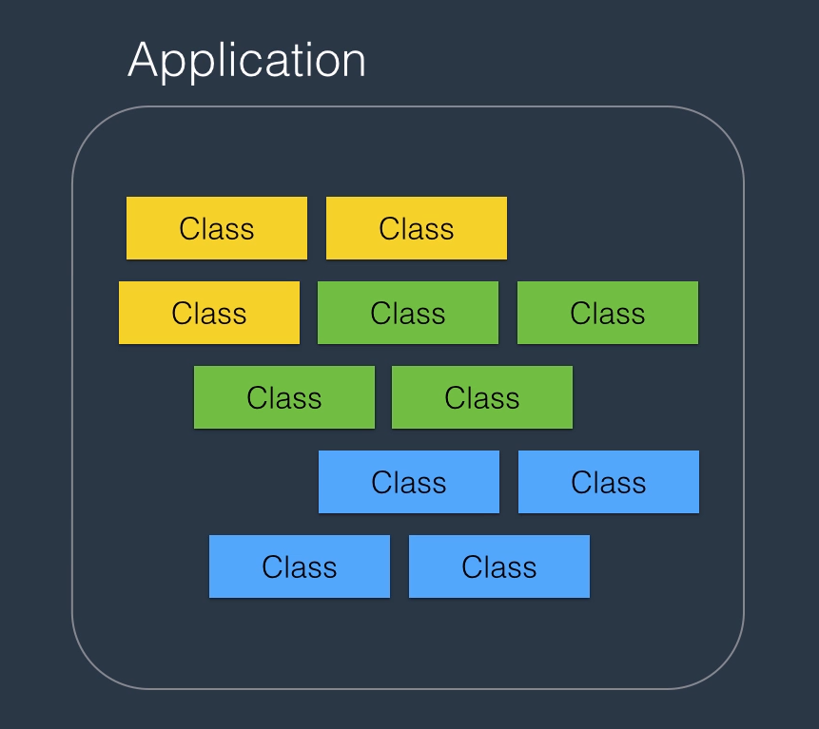
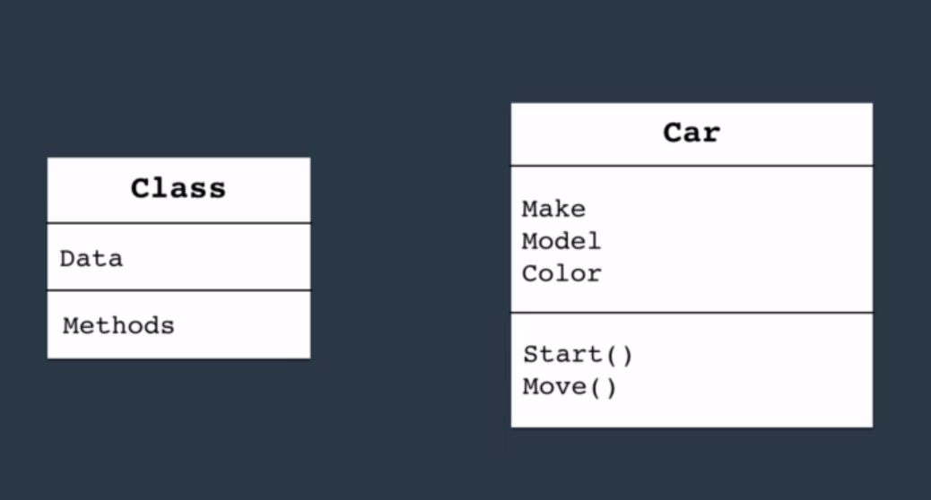
Architecture of .Net Applications

Slide 5
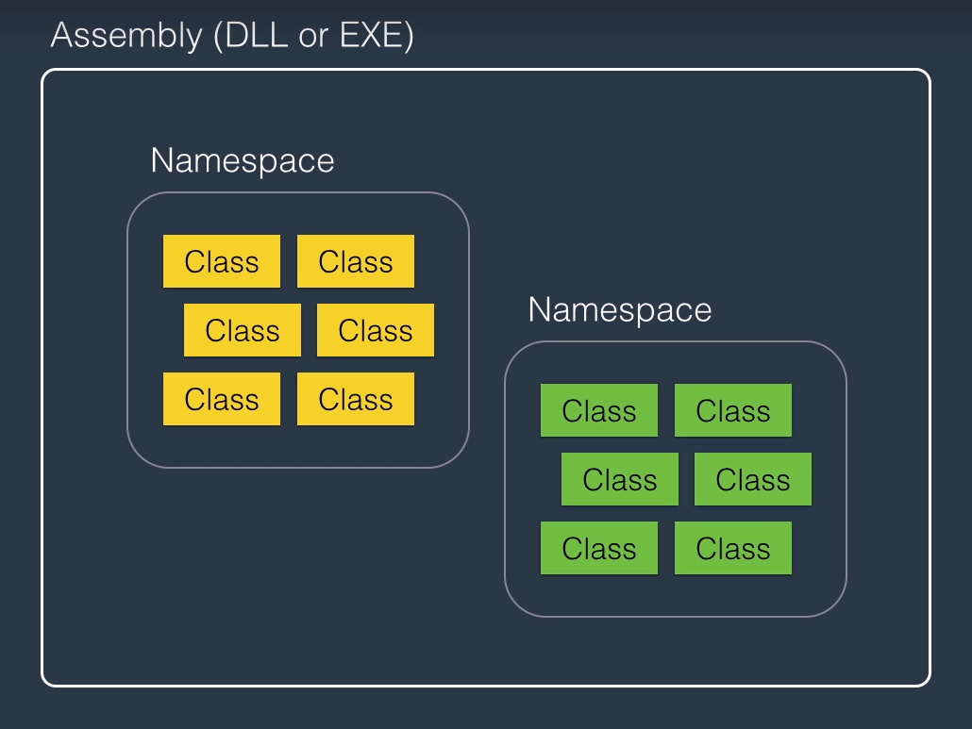
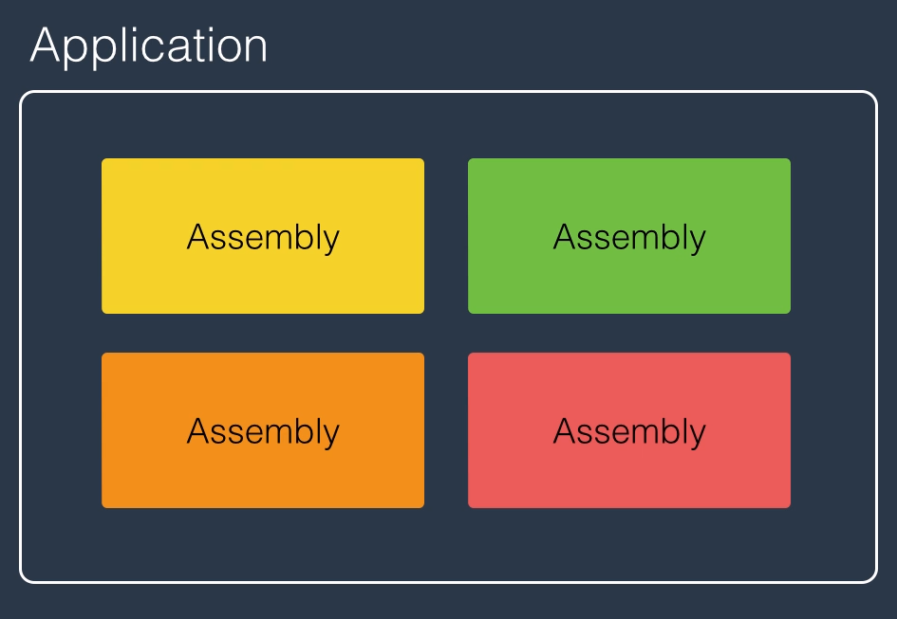

Slide 6
Get Visual Studio IDE
To write C# code, you need Microsoft Visual Studio. Visual Studio comes in different editions: Community, Professional and Ultimate. As an individual, or a student or a small team, you can download Visual Studio Community Edition for free and build your free or paid apps with it.
To download Visual Studio Community Edition, please visit:
https://www.visualstudio.com/en-us/products/visual-studio-community-vs.aspx

Slide 7
Quiz Time
1. What is a namespace?
A type that contains code for the program
A container for classes
A deployable unit of an application
Answer: B
2. What is JIT Compilation?
The compilation of IL code to native machine code at runtime
The compilation of C# code to native code
The compilation of C# code to IL code
Answer: A
3. What is an assembly?
A piece of code that is executed by CLR
Container of one or more classes
A single unit of deployment of .NET applications
Answer: C

Slide 8
Summary:
C# vs .NET
C# is a programming language, while .NET is a framework. It consists of a run-time environment (CLR) and a class library that we use for building applications.
CLR
When you compile an application, C# compiler compiles your code to IL (Intermediate Language) code. IL code is platform agnostics, which makes it possible to a take a C# program on a different computer with different hardware architecture and operating system and run it. For this to happen, we need CLR. When you run a C# application, CLR compiles the IL code into the native machine code for the computer on which it is running. This process is called Just-in-time Compilation (JIT).

Slide 9
Continue..
Architecture of .NET Applications
In terms of architecture, an application written with C# consists of building blocks called classes. A class is a container for data (attributes) and methods (functions). Attributes represent the state of the application. Methods include code. They have logic. That's where we implement our algorithms and write code.
A namespace is a container for related classes. So as your application grows in size, you may want to group the related classes into various namespaces for better maintainability.
As the number of classes and namespaces even grow further, you may want to physically separate related namespaces into separate assemblies. An assembly is a file (DLL or EXE) that contains one or more namespaces and classes. An EXE file represents a program that can be executed. A DLL is a file that includes code that can be re-used across different programs.

Slide 10
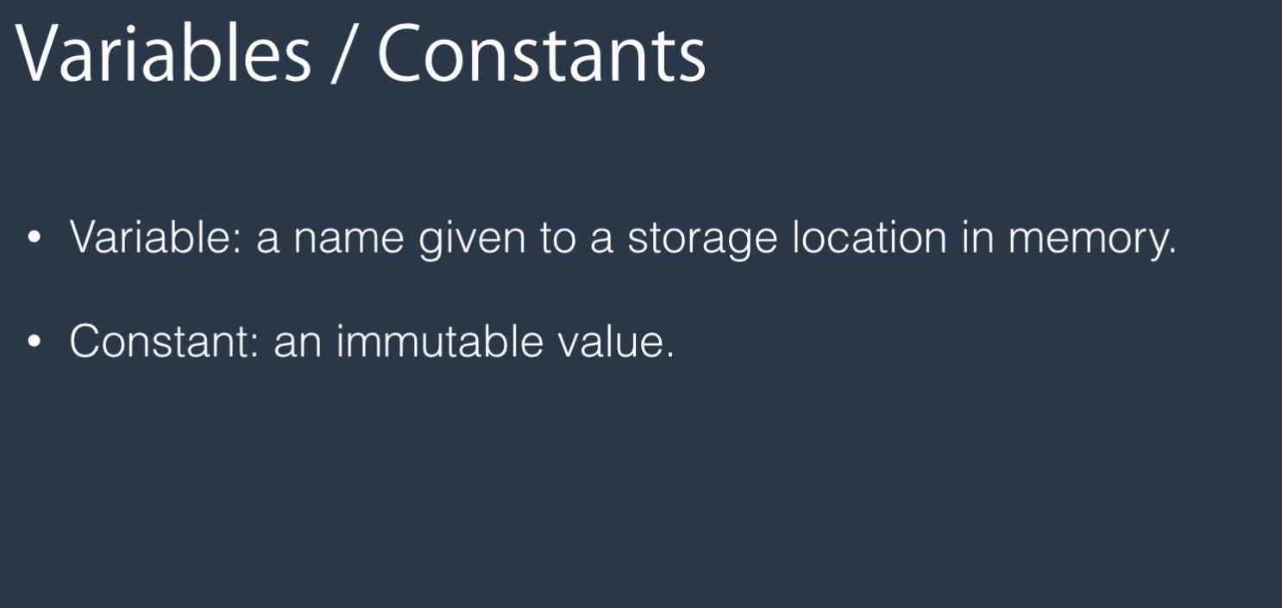
Variables and Constants

Slide 11


Slide 12
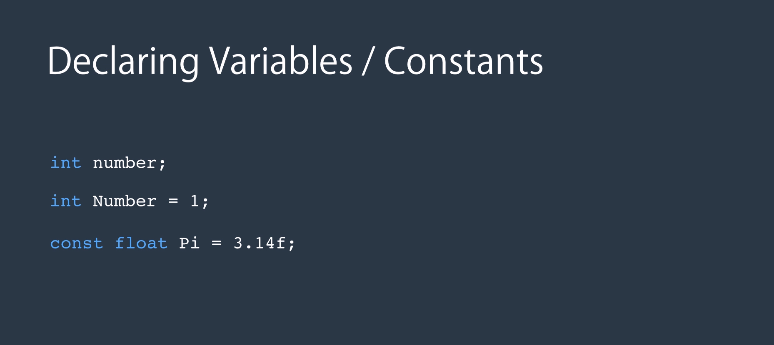
Type
Identifier
semicolon

Slide 13


Slide 14
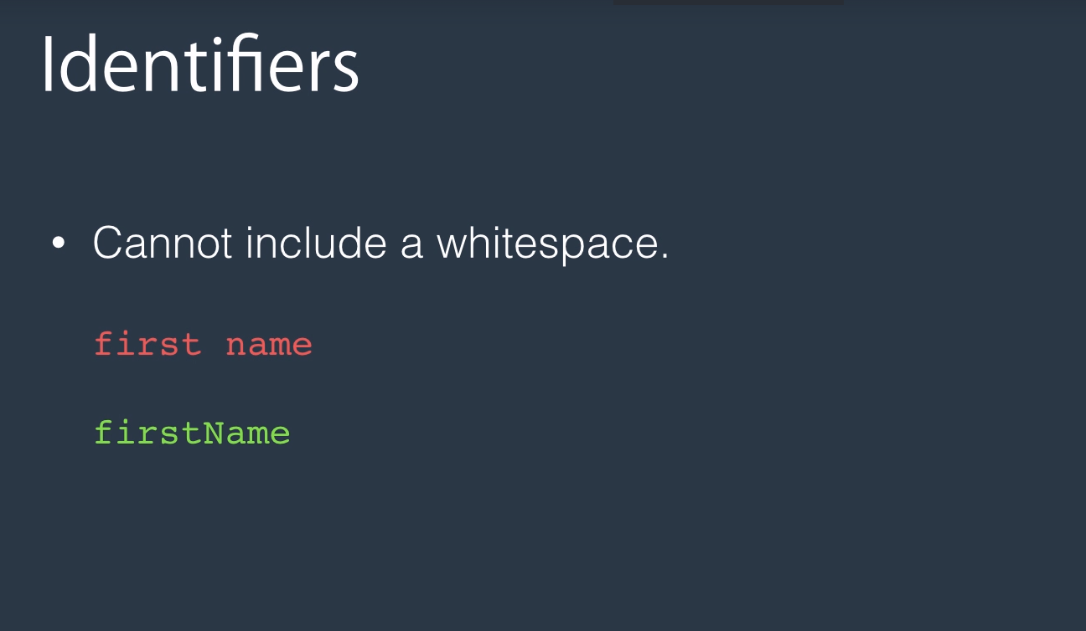

Slide 15
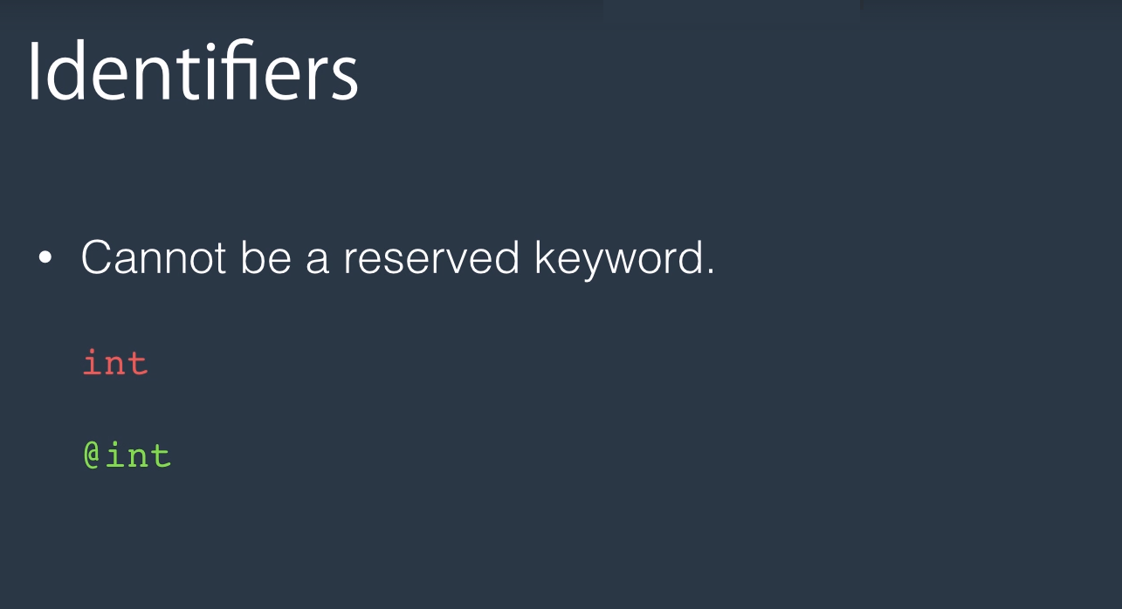

Slide 16
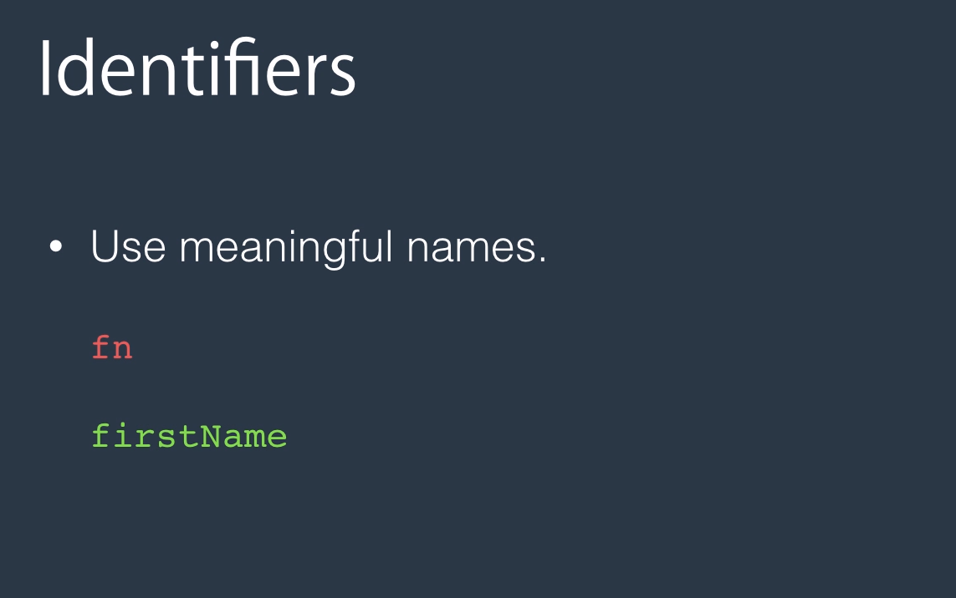

Slide 17
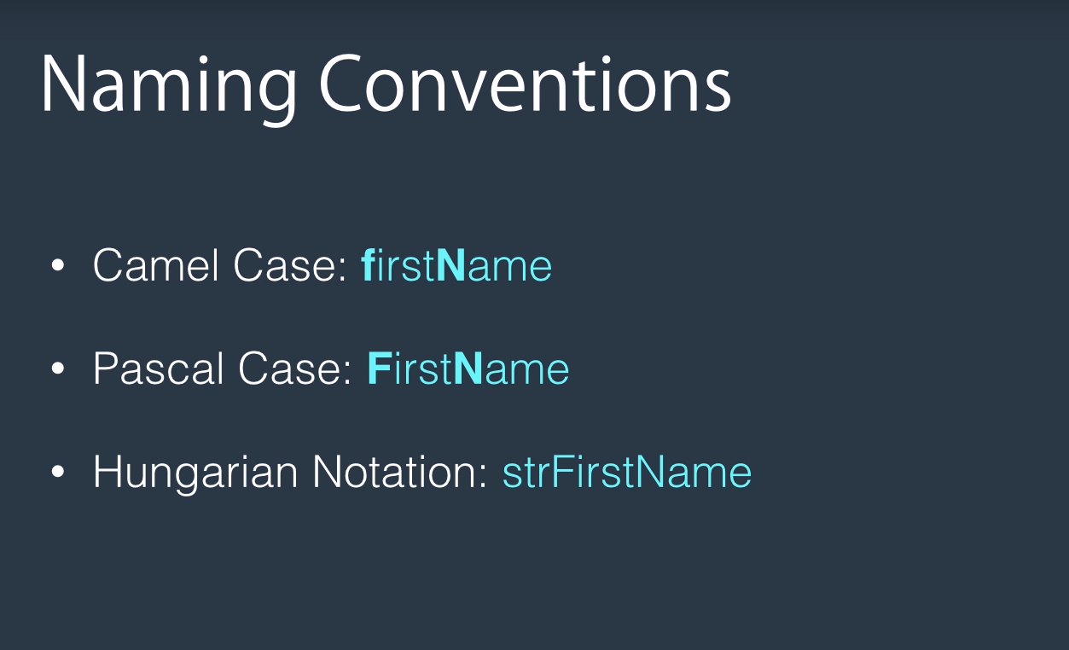

Slide 18
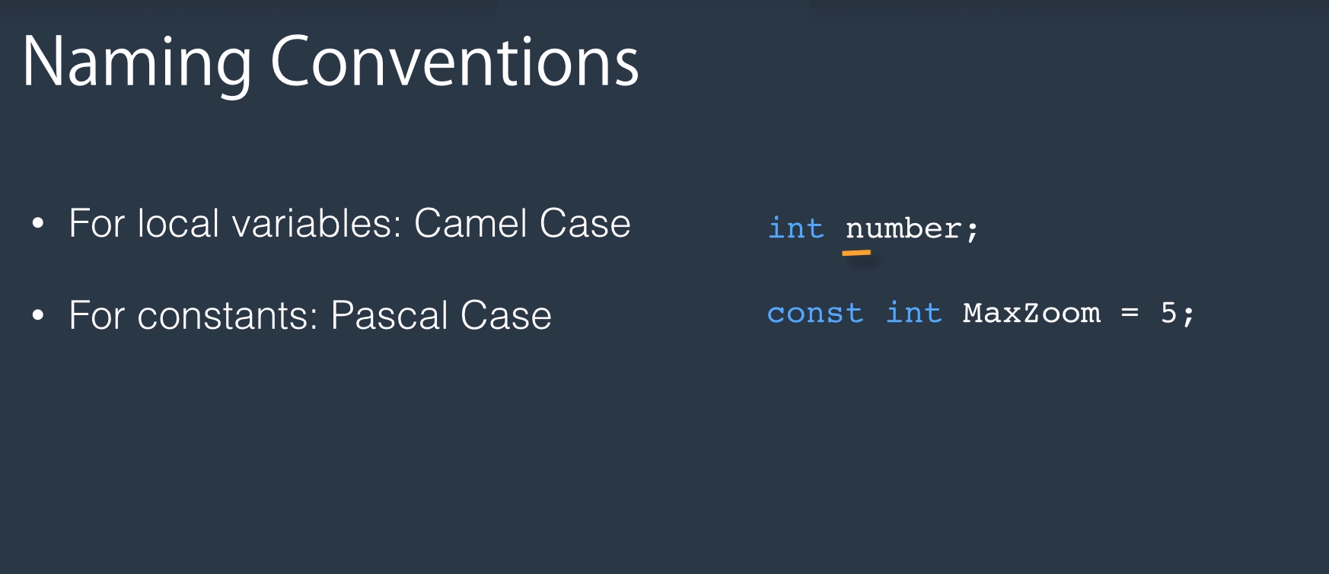

Slide 19
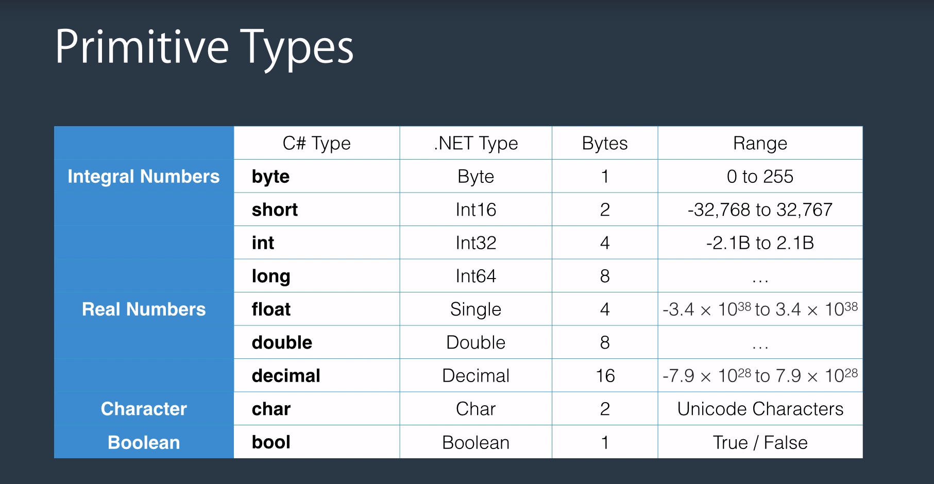

Slide 20
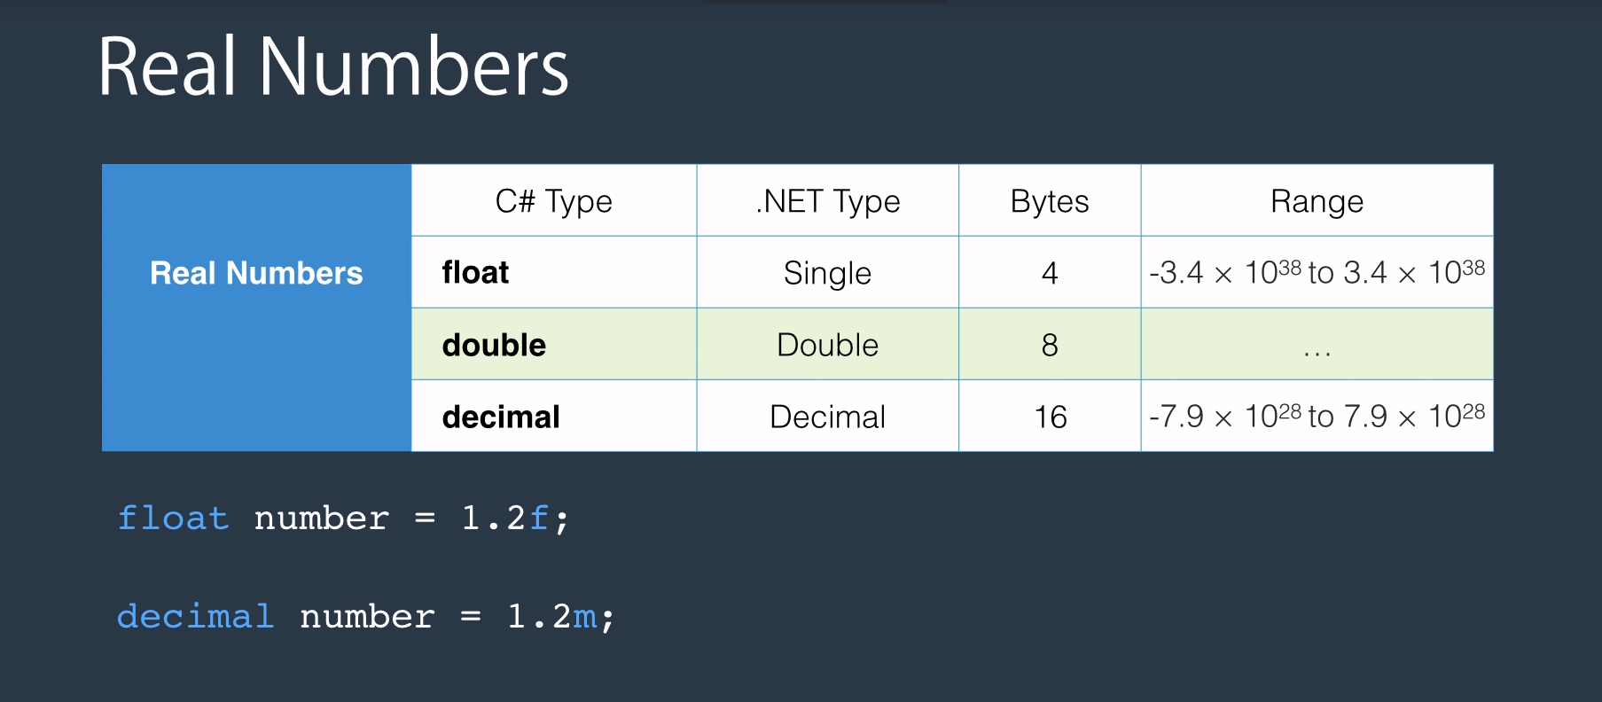

Slide 21
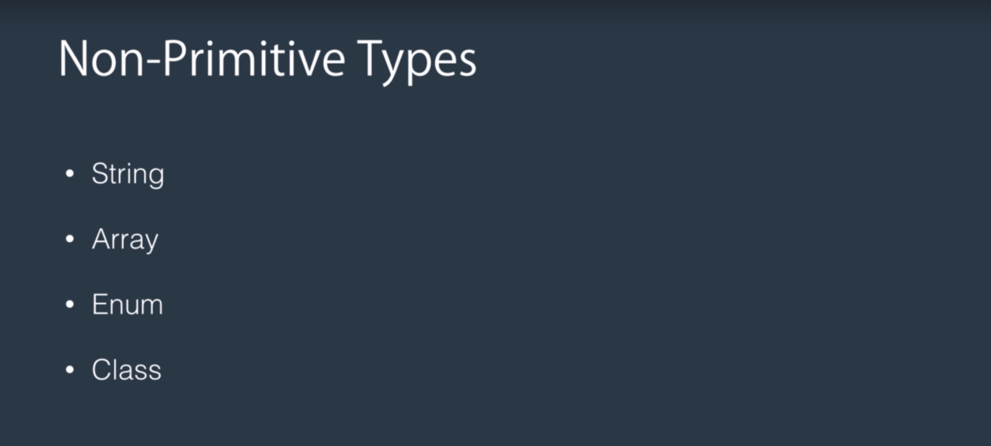
Continue..
In the C-Sharp,

Slide 22
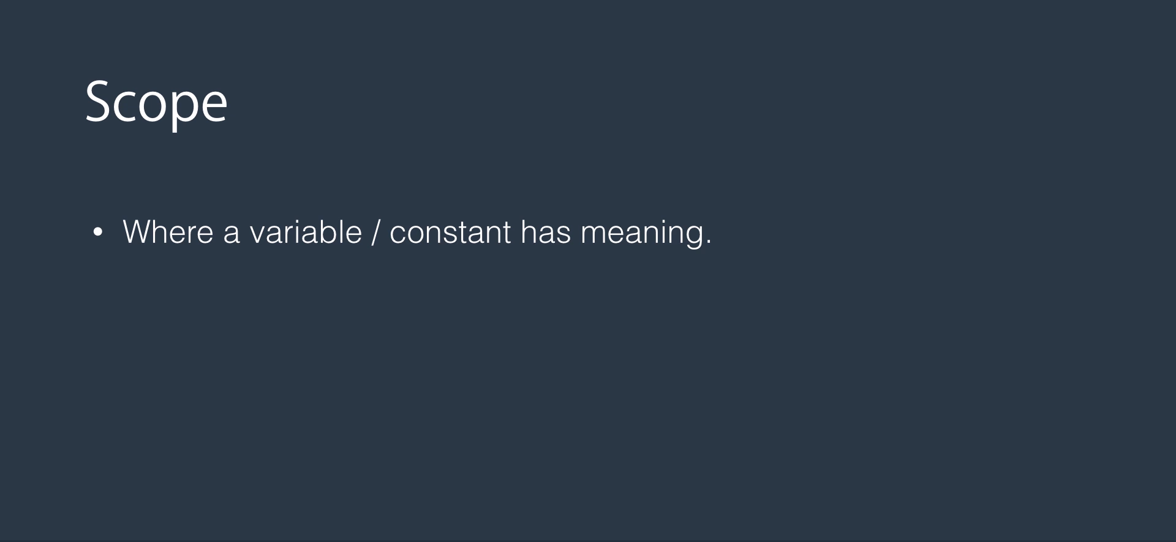

Slide 23


Slide 24
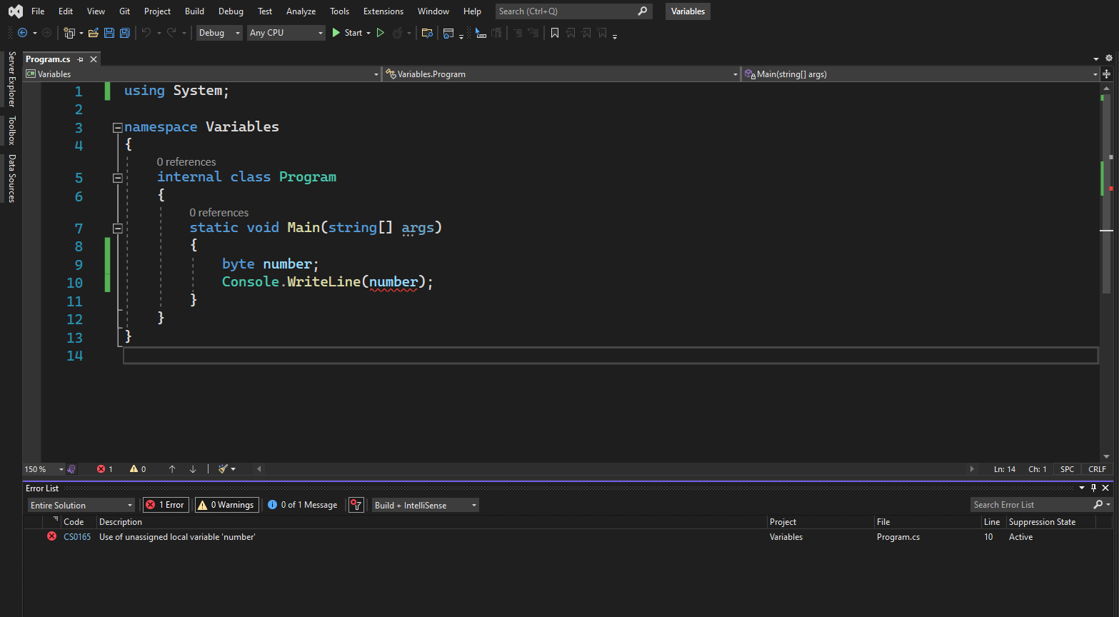

Slide 25
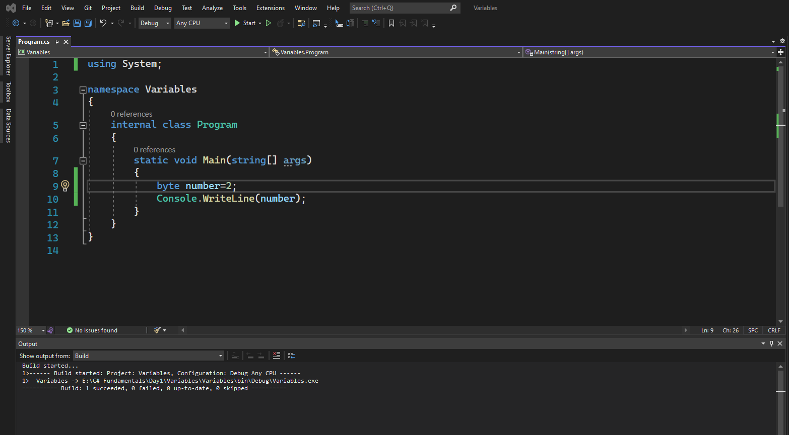
Build: Ctrl + Shift + b

Slide 26
Now we can run the application by pressing control and F5.
OK.
Run: Ctrl + F5

Slide 27
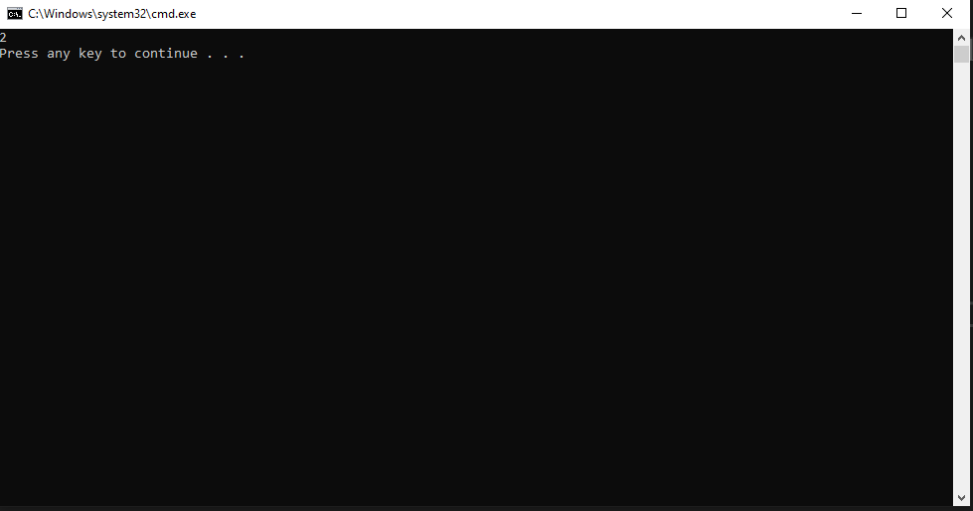

Slide 28
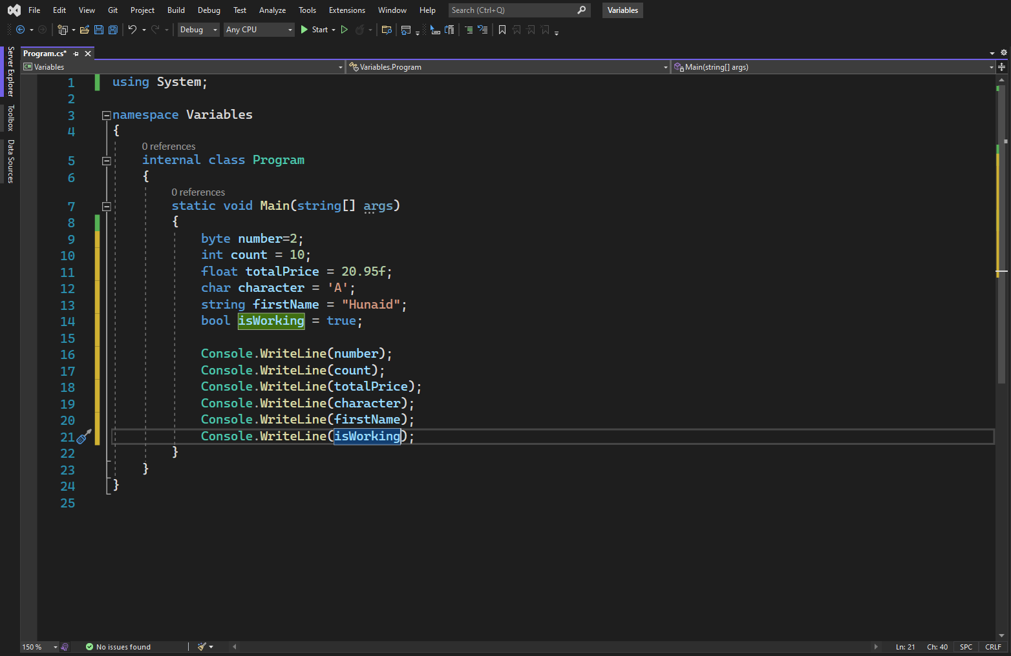

Slide 29


Slide 30
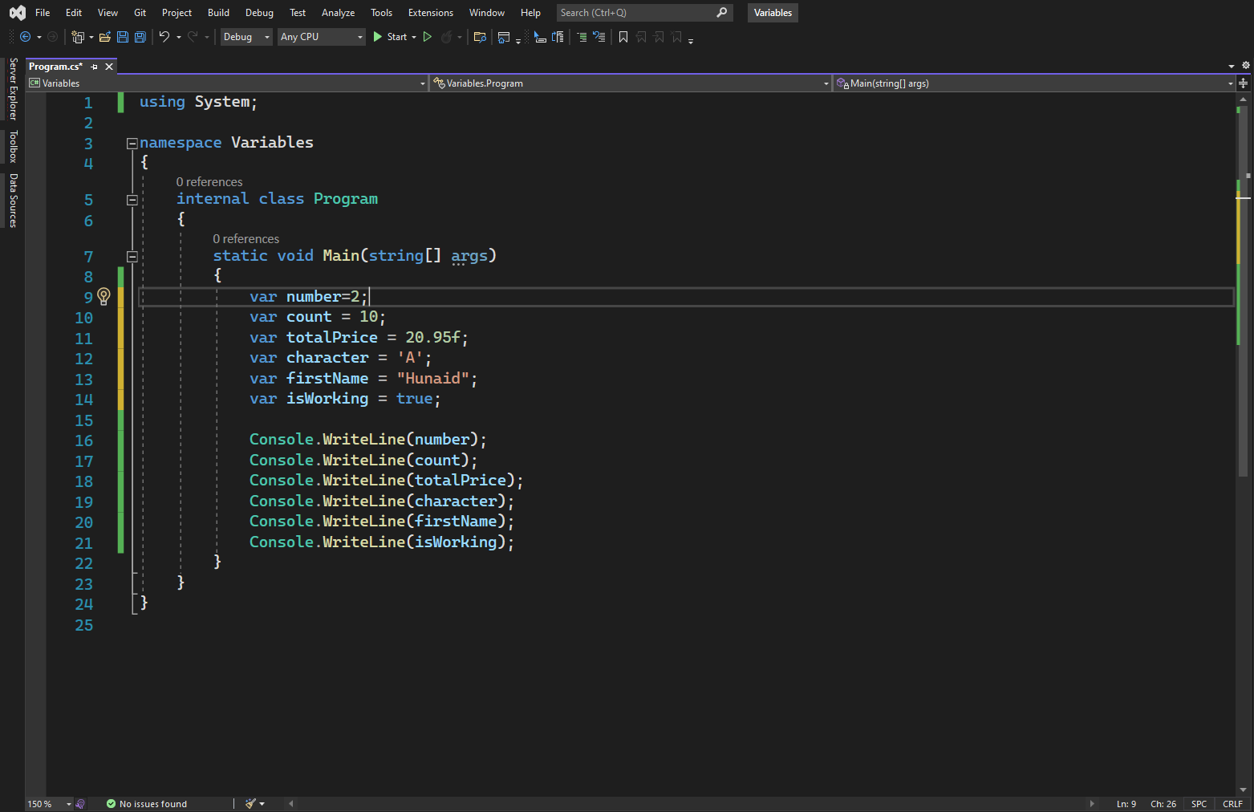

Slide 31
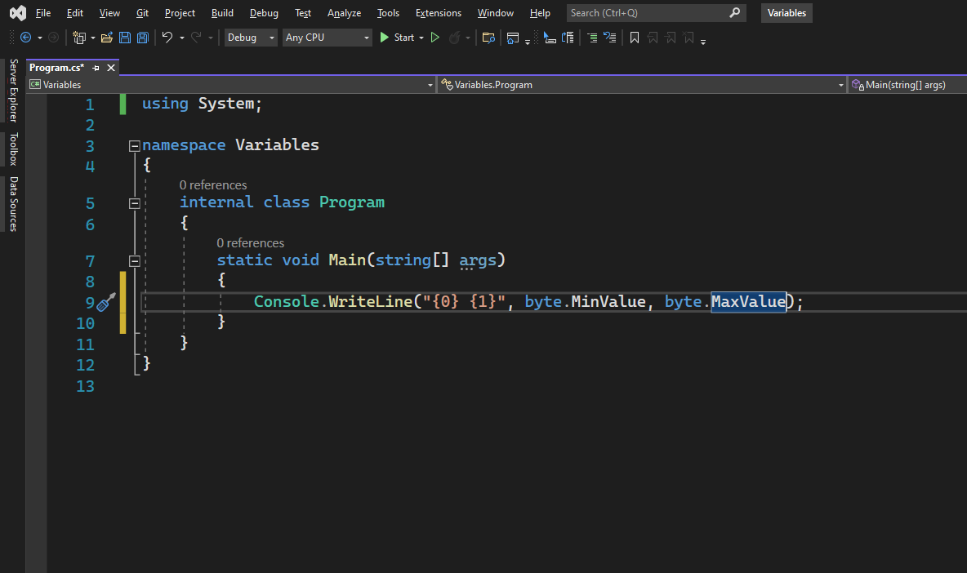

Slide 32
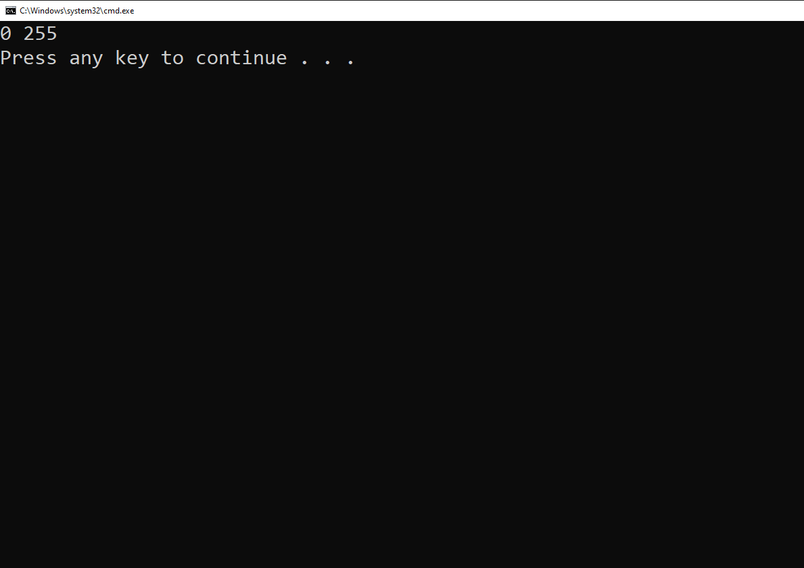

Slide 33
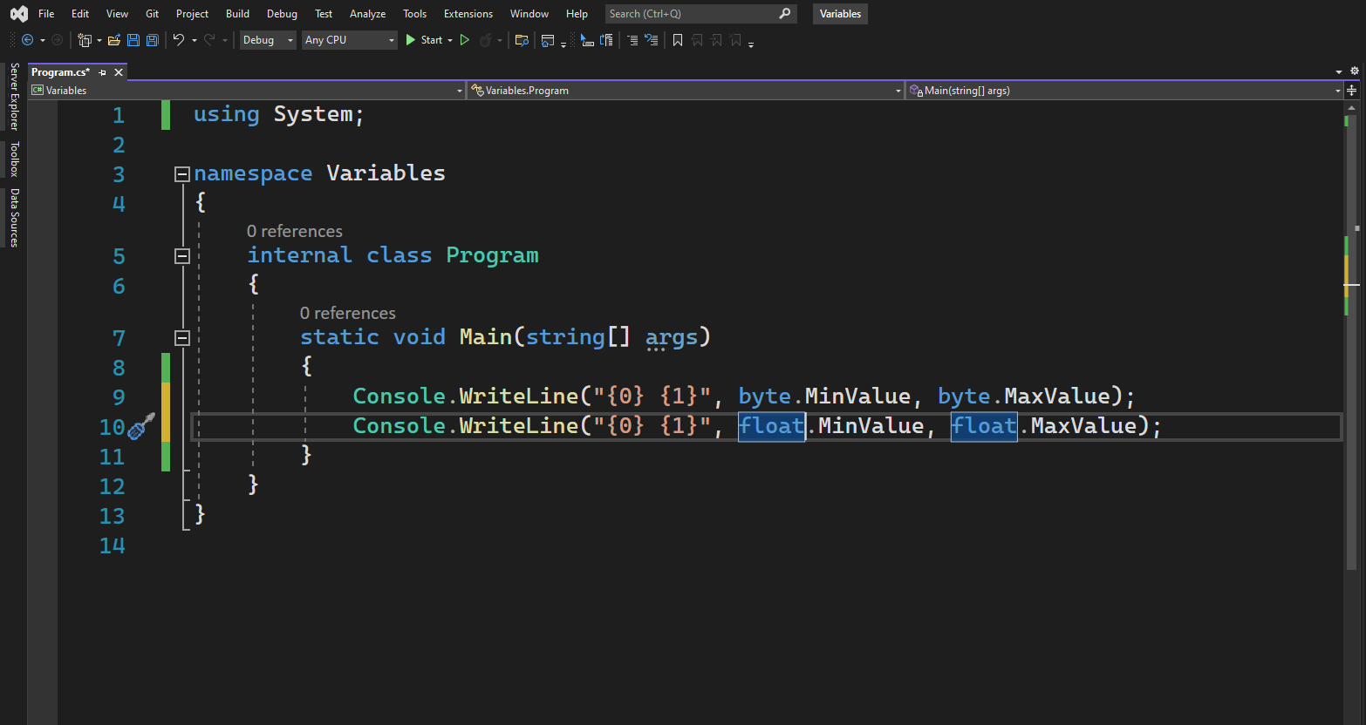

Slide 34


Slide 35
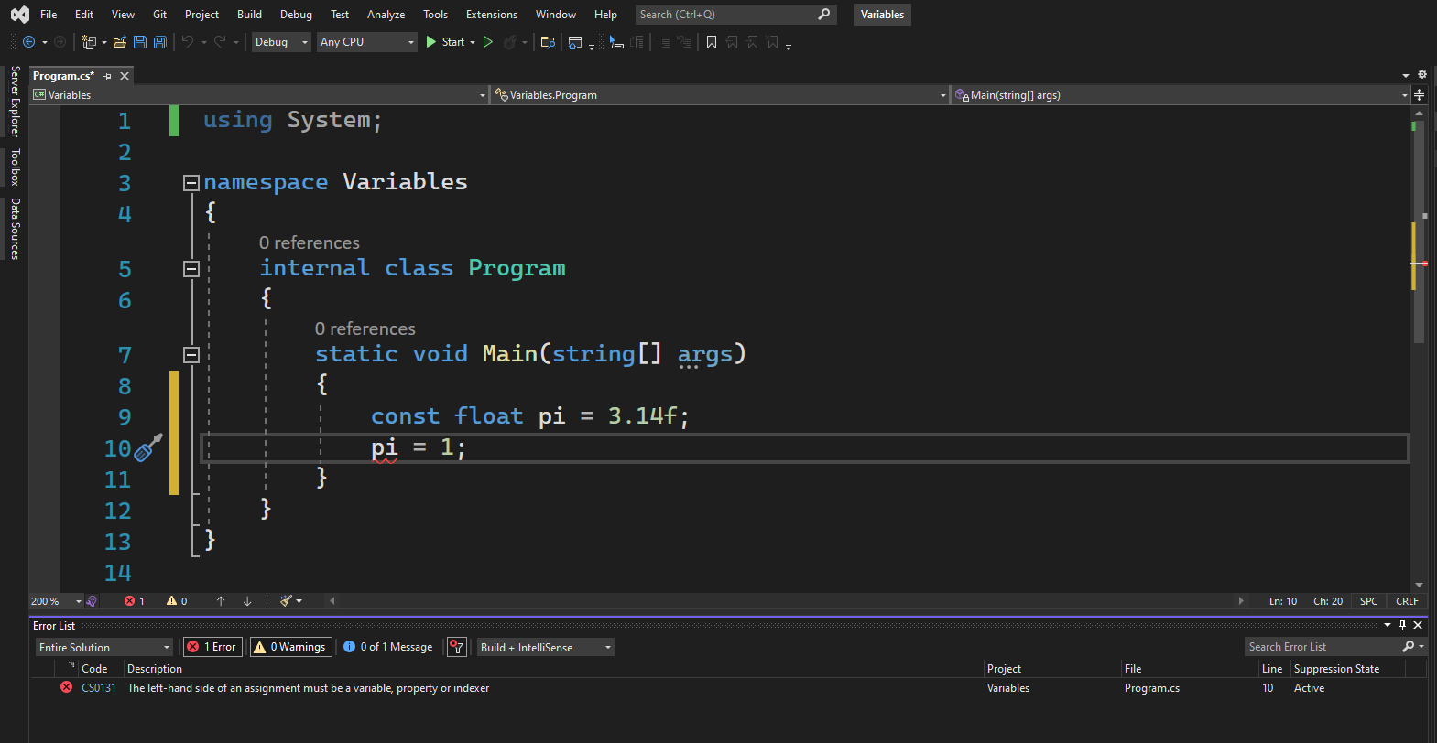

Slide 36
Continue..
In the C-Sharp,

Slide 39
Build: Ctrl + Shift + b

Slide 40
Build: Ctrl + Shift + b

Slide 41
Now we can run the application by pressing control and F5.
OK.
Run: Ctrl + F5

Slide 51


Slide 52
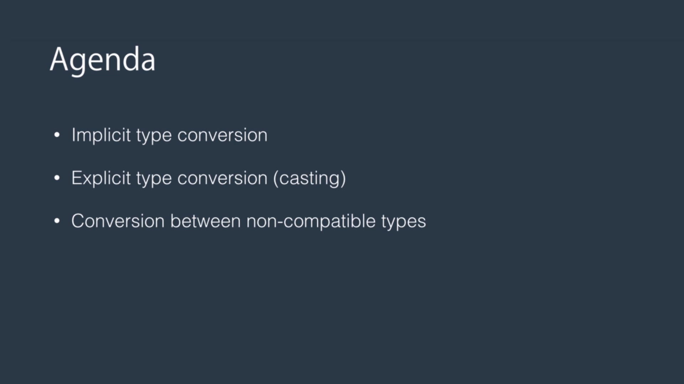

Slide 53
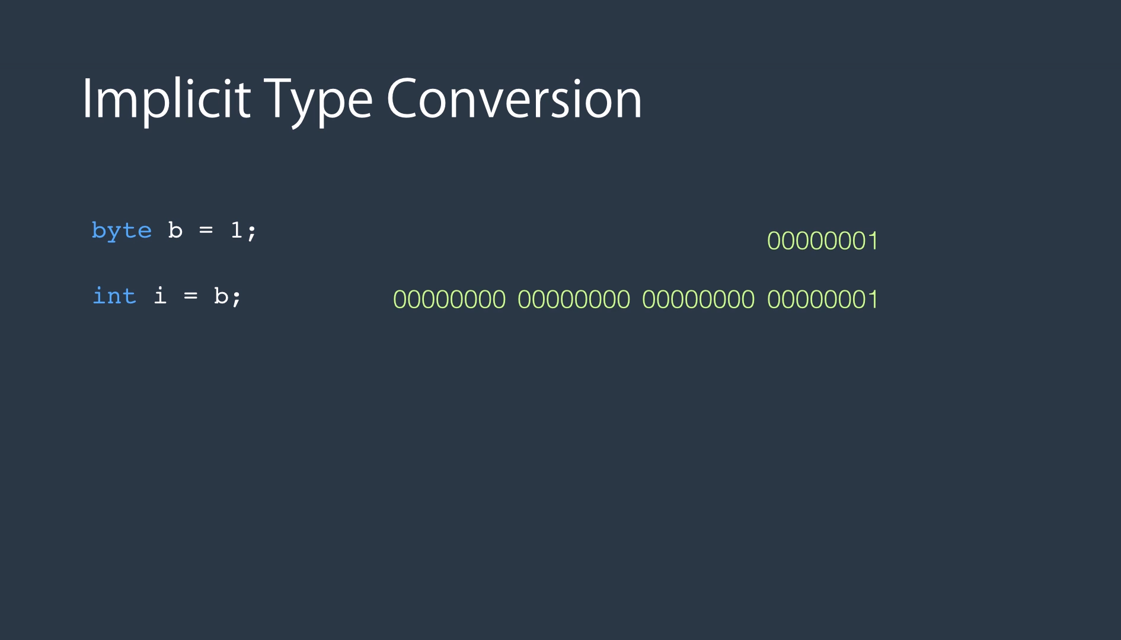

Slide 54
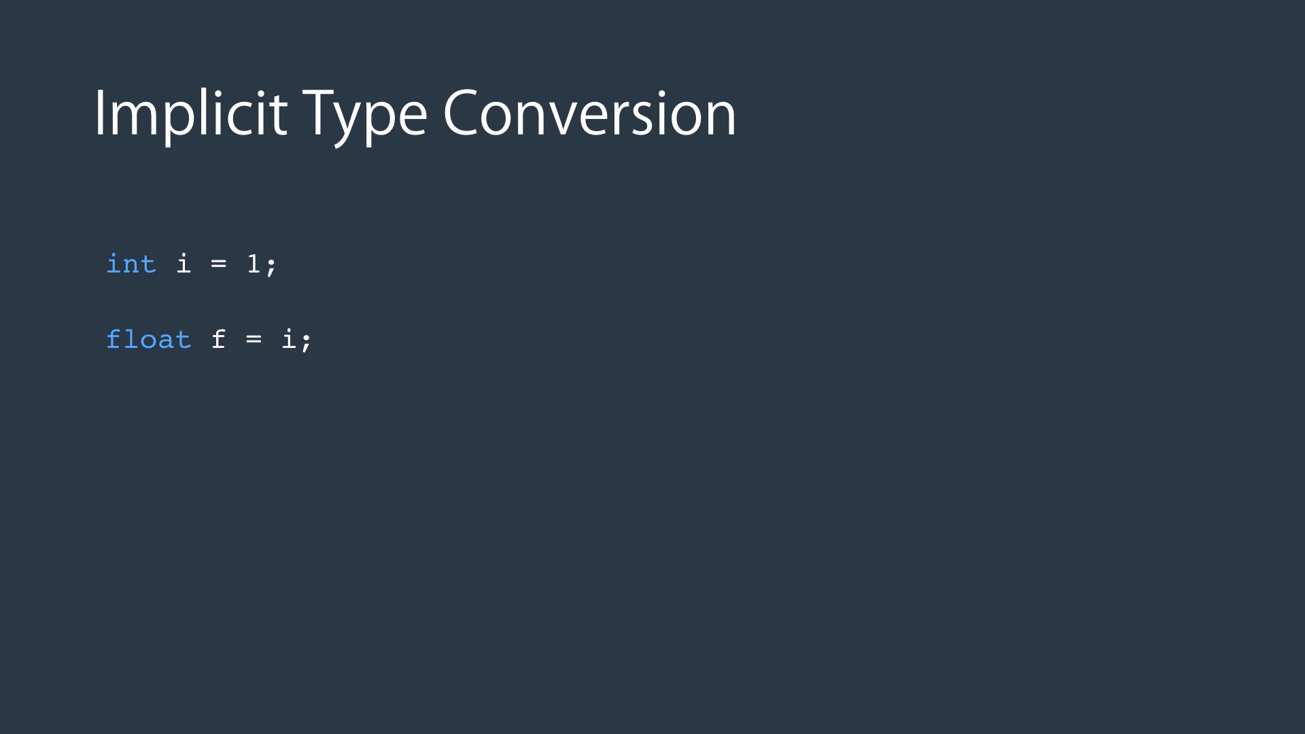

Slide 55
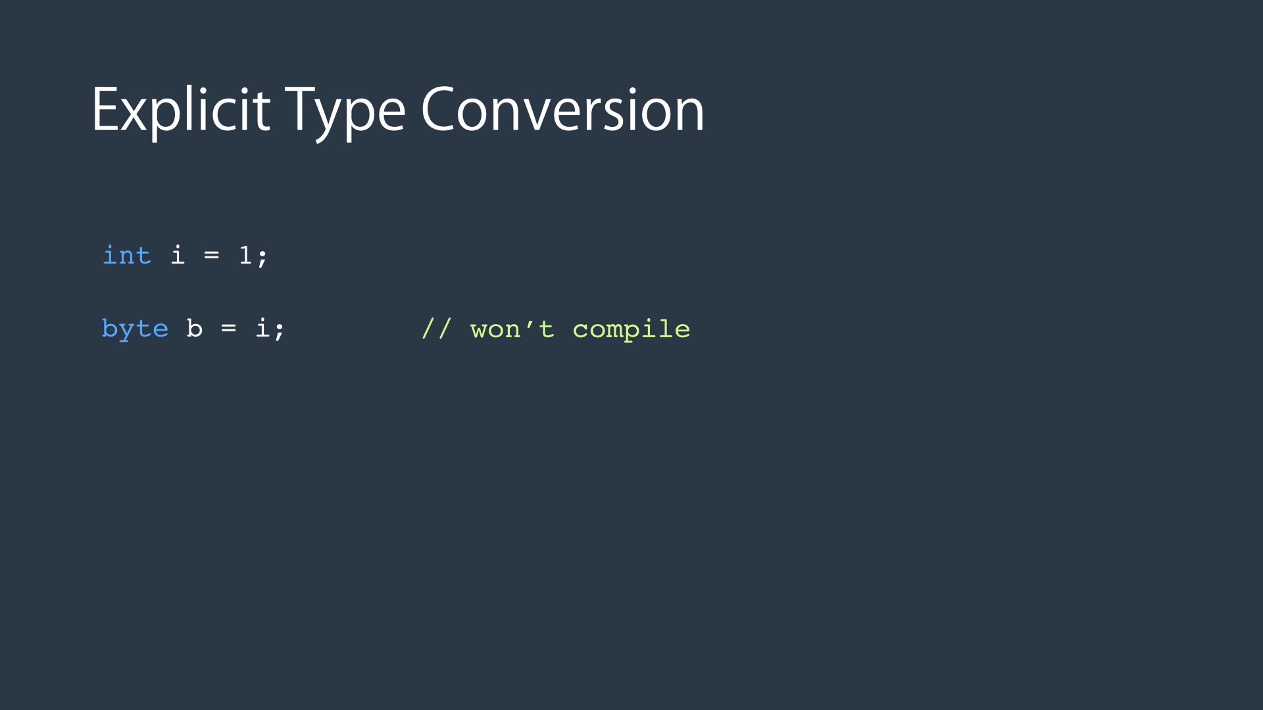

Slide 56
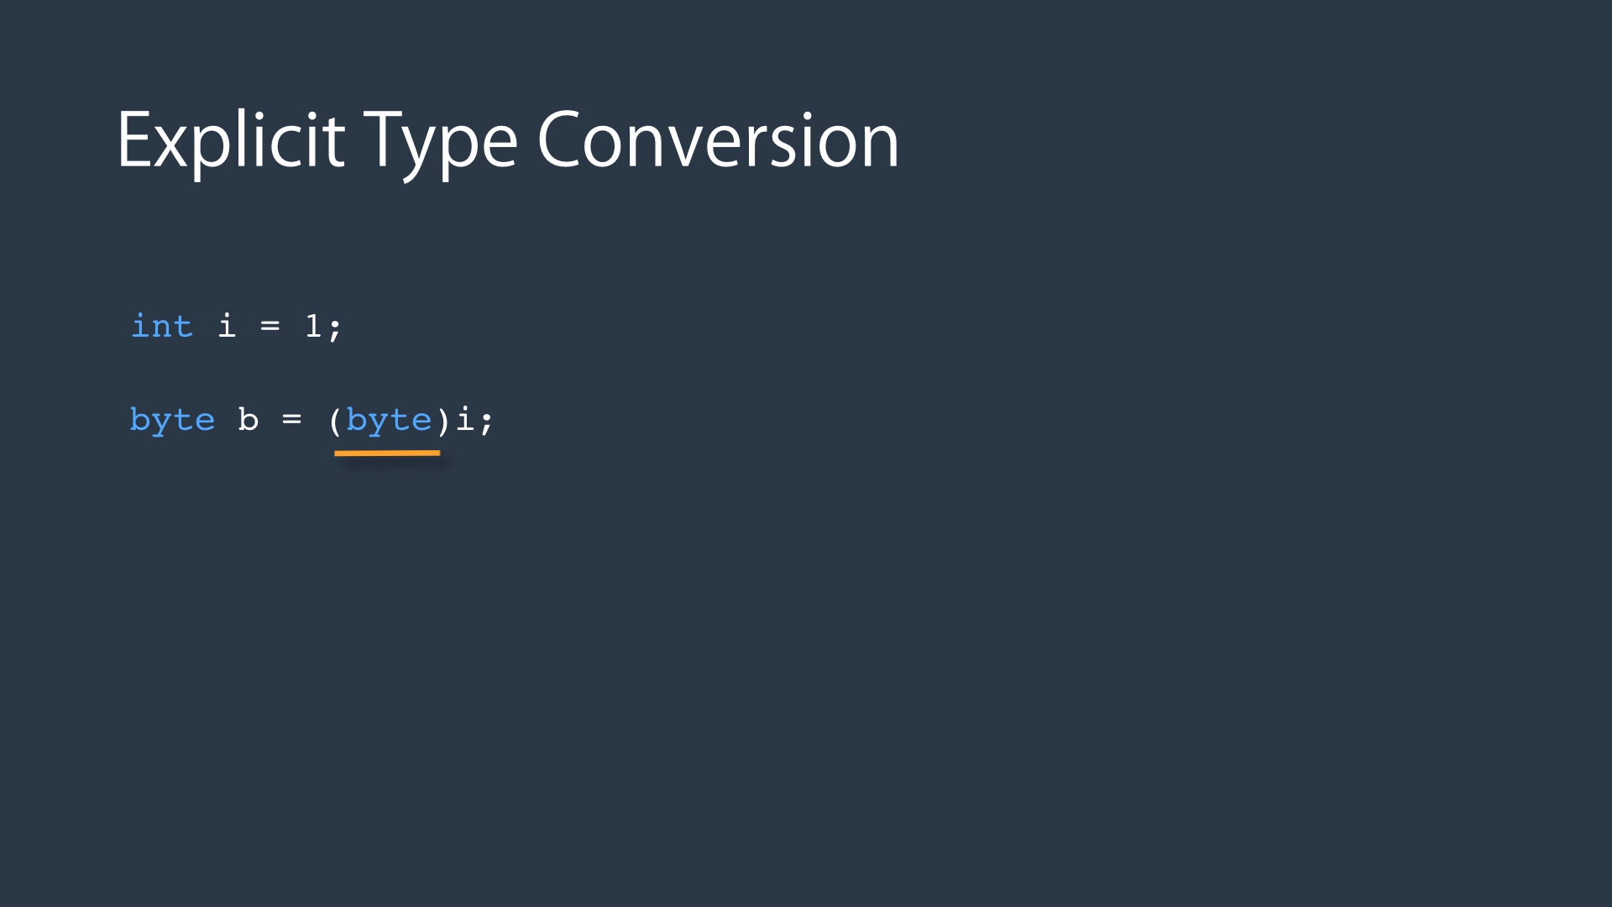

Slide 57
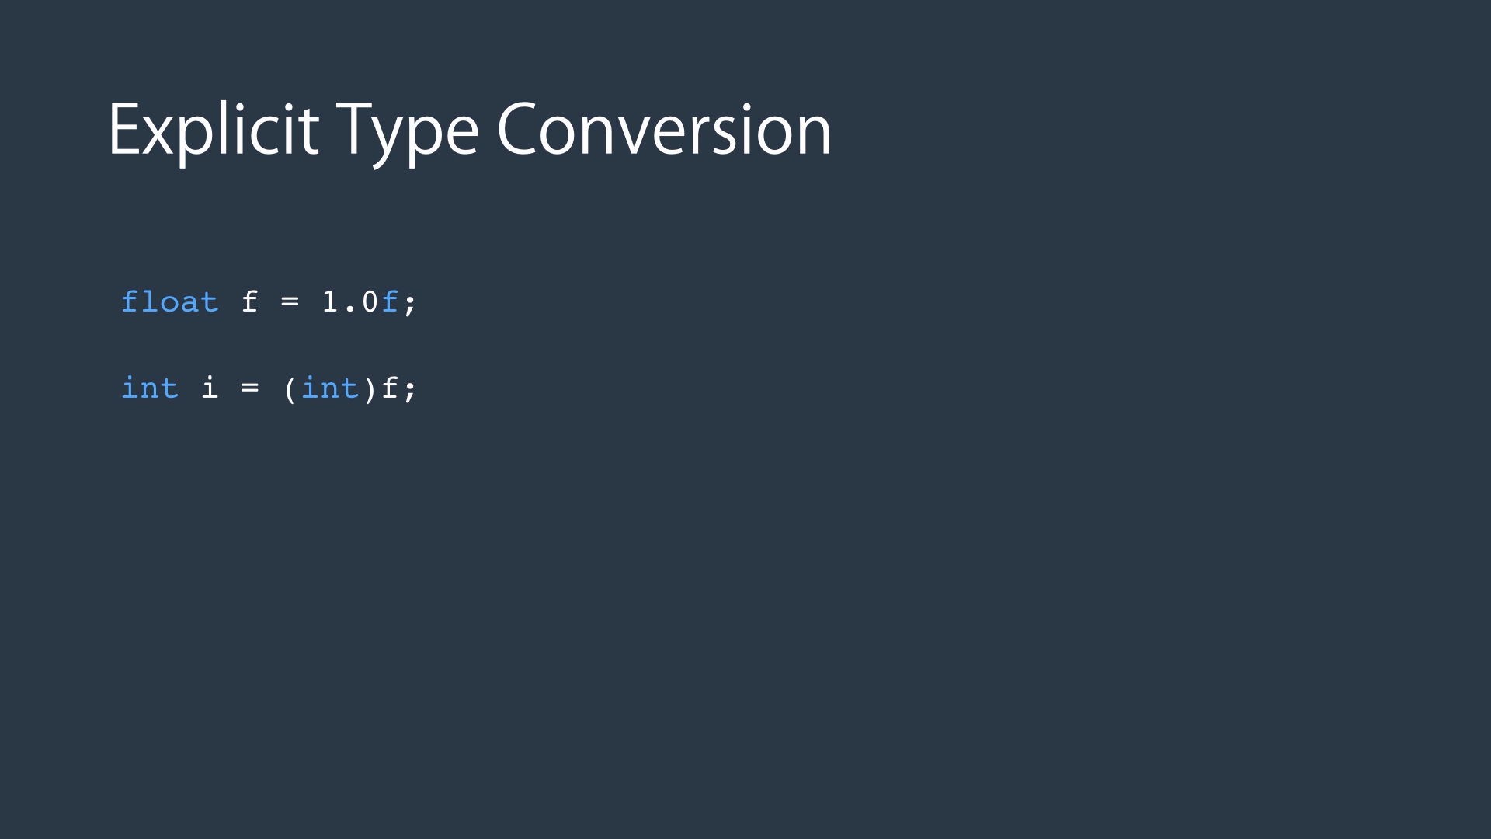

Slide 58
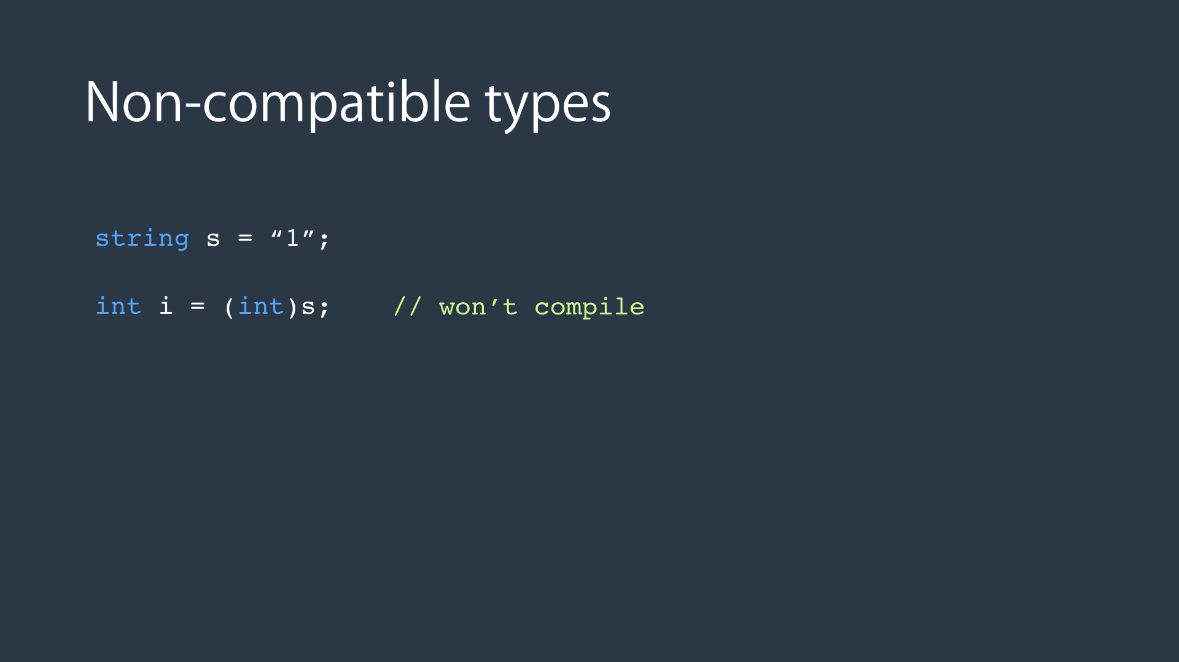

Slide 59
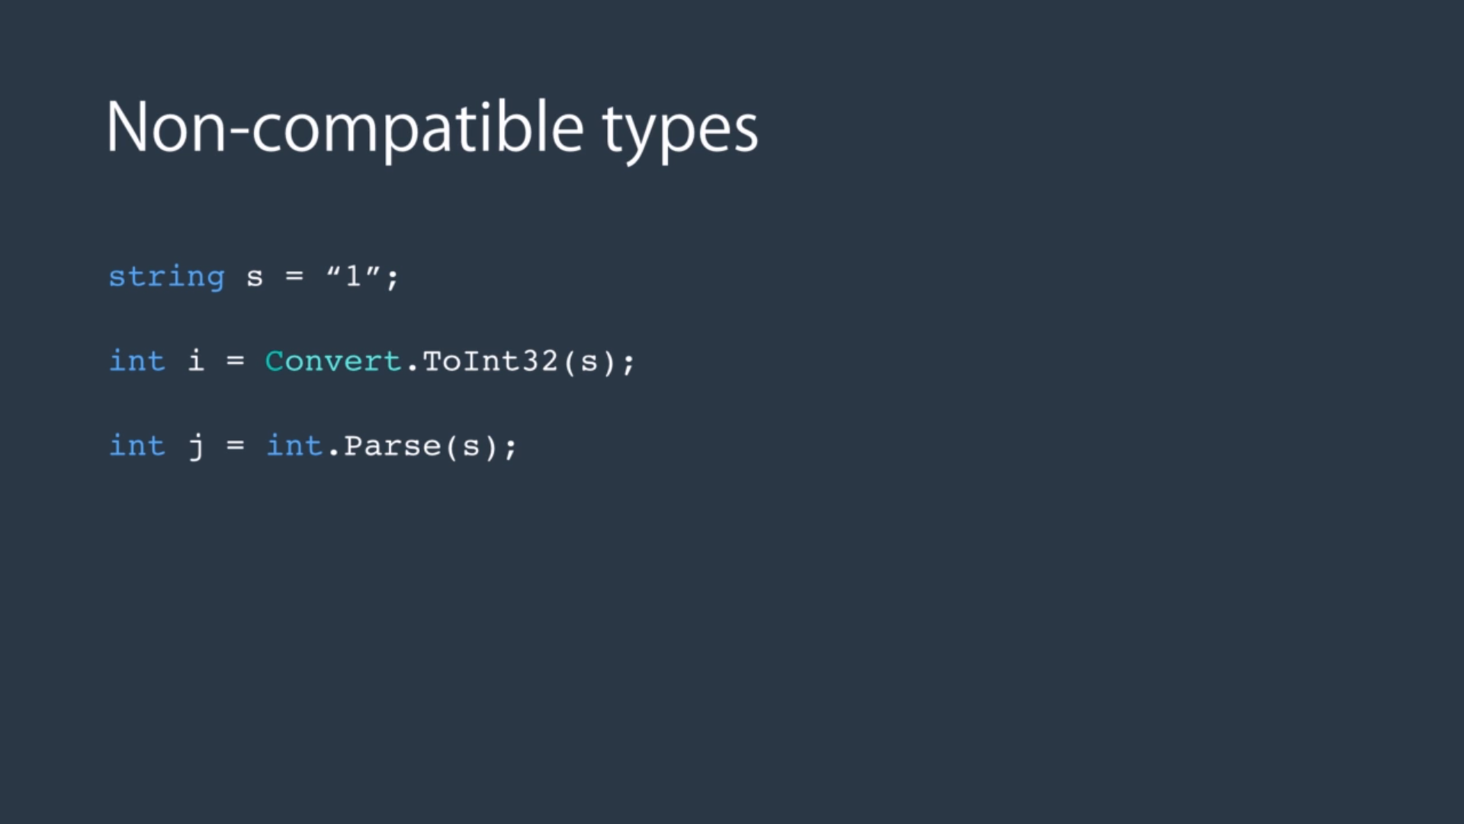

Slide 60


Slide 61
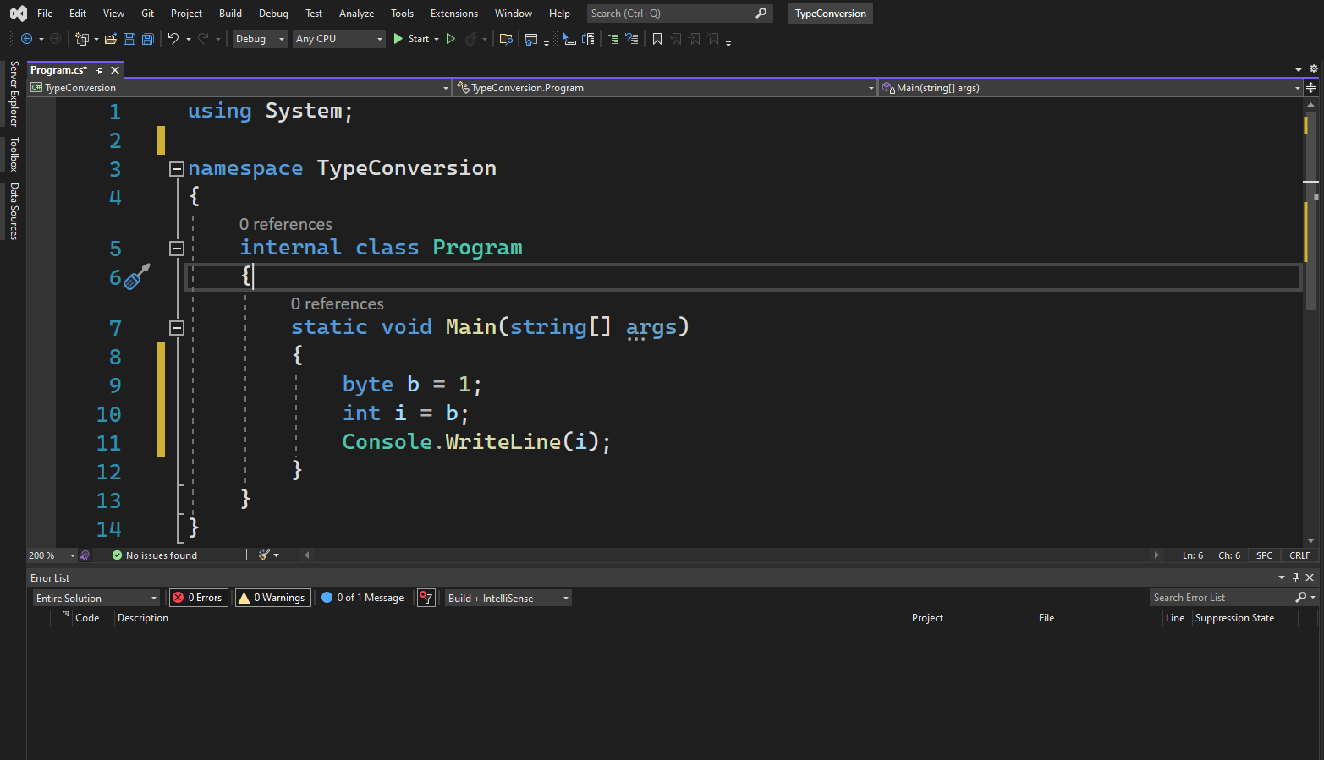

Slide 62
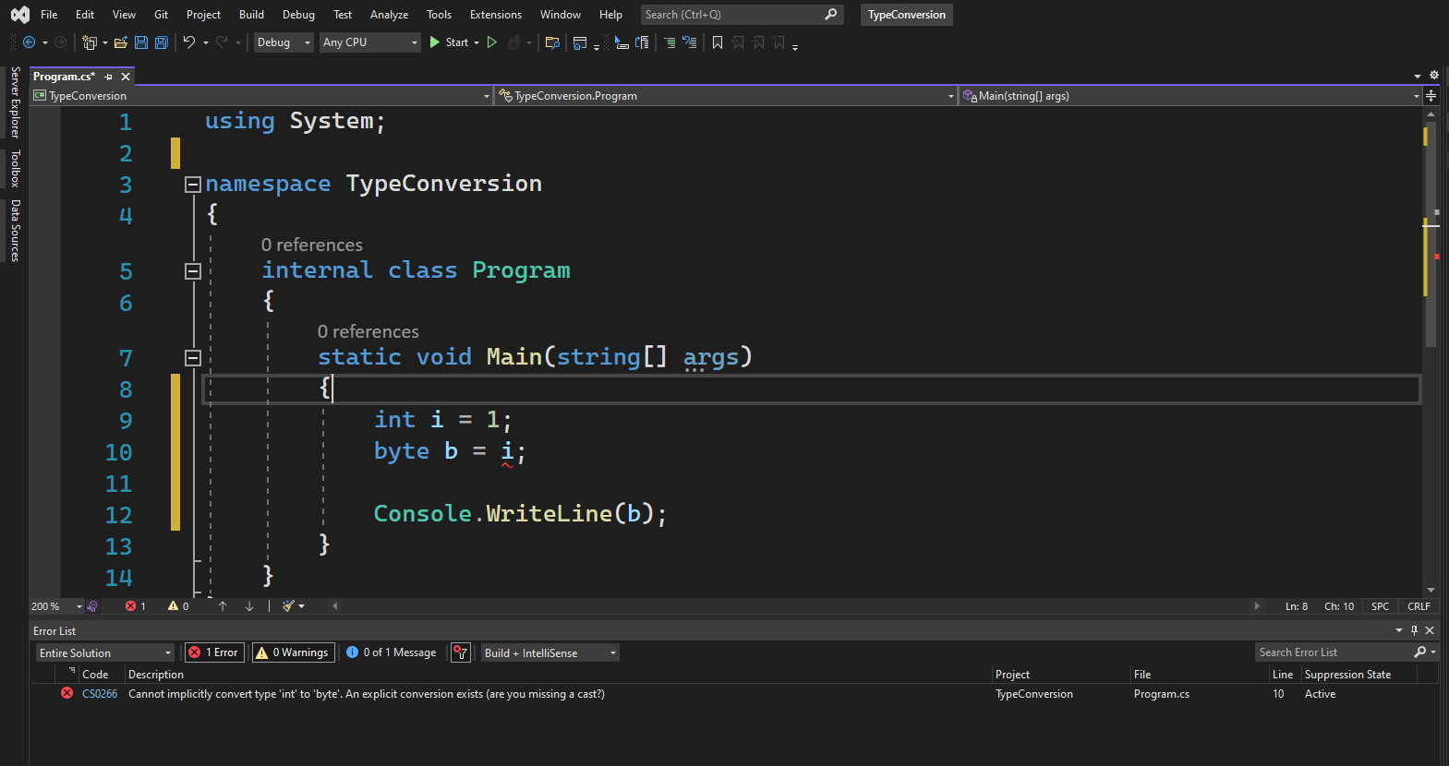

Slide 63


Slide 64
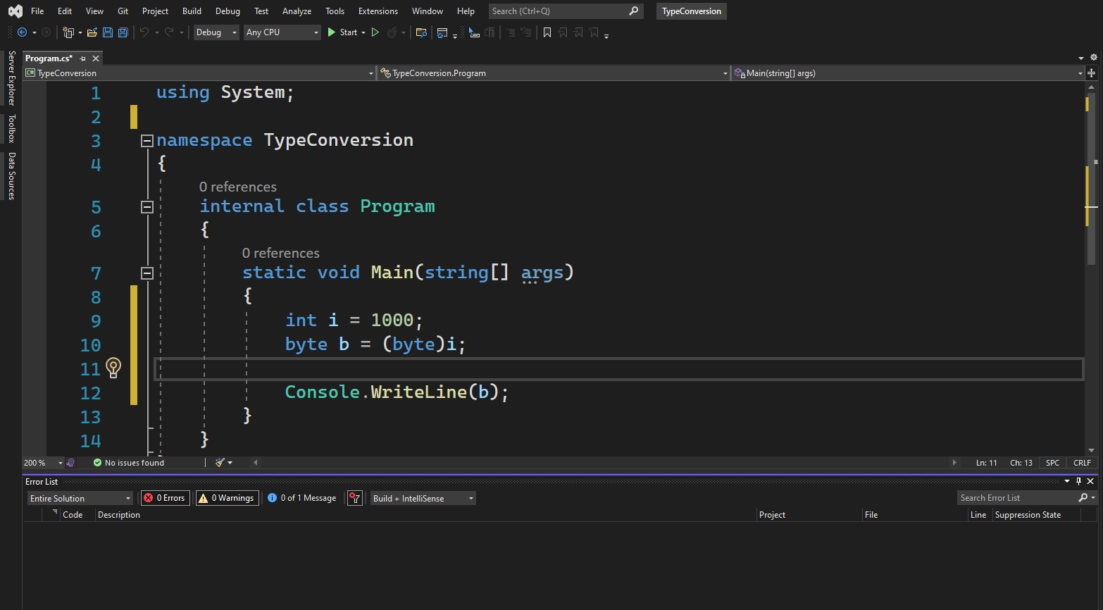

Slide 65
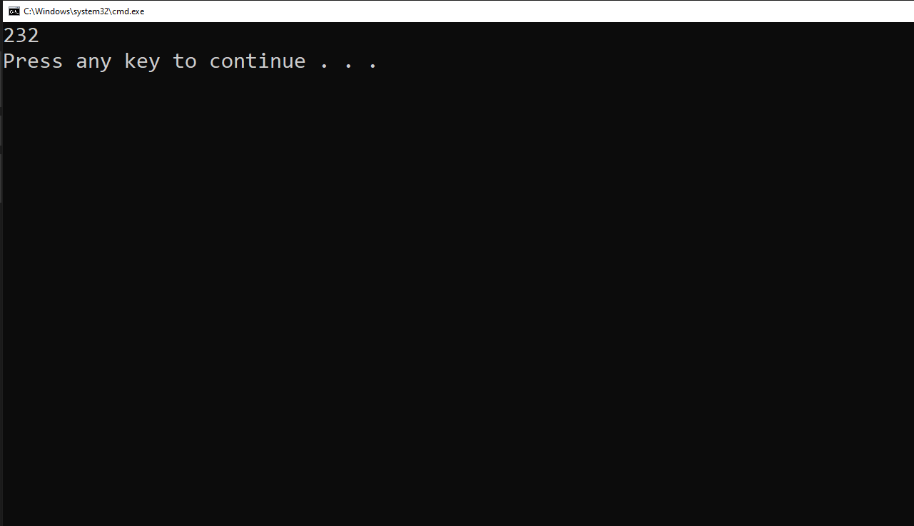

Slide 66
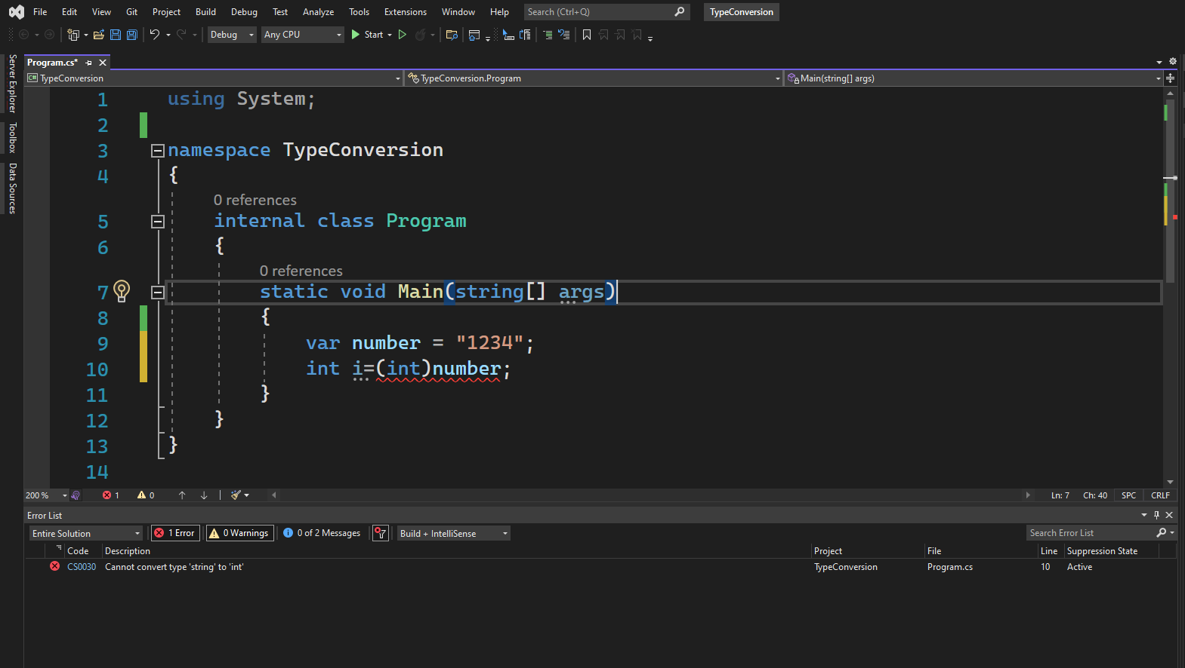

Slide 67
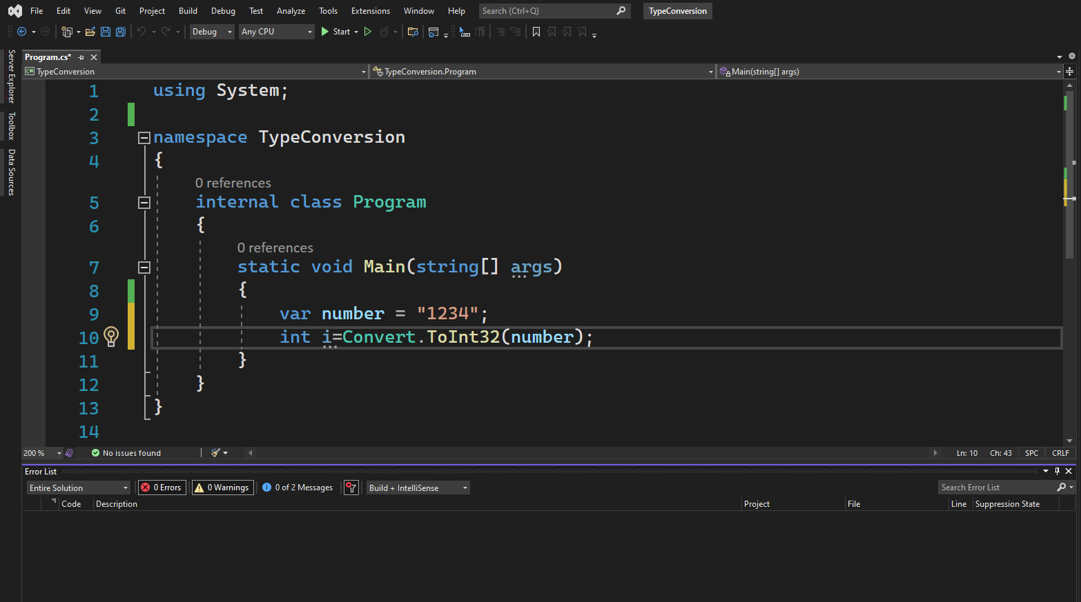

Slide 68


Slide 69
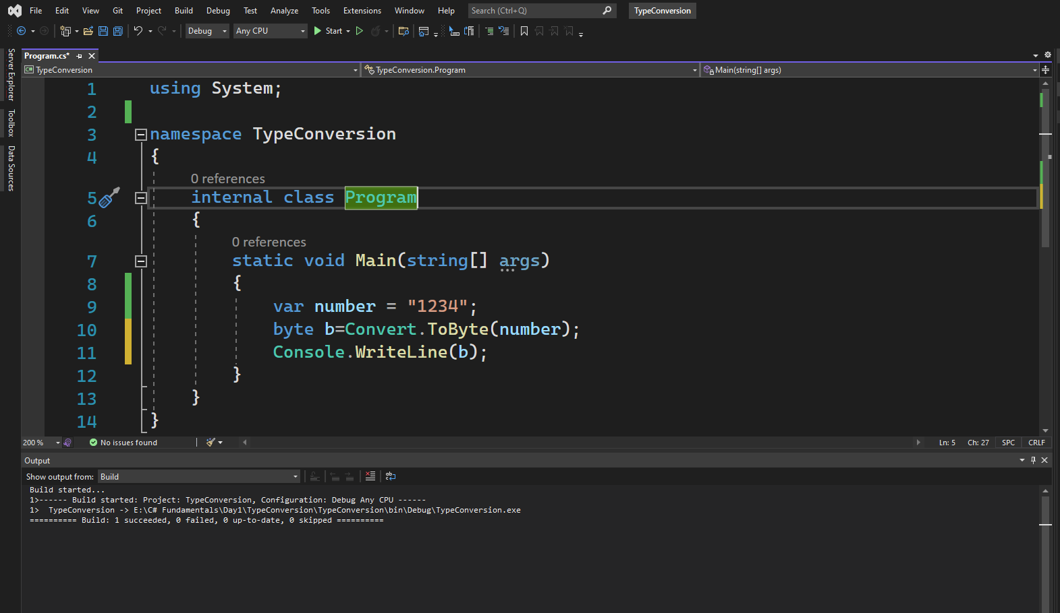

Slide 70
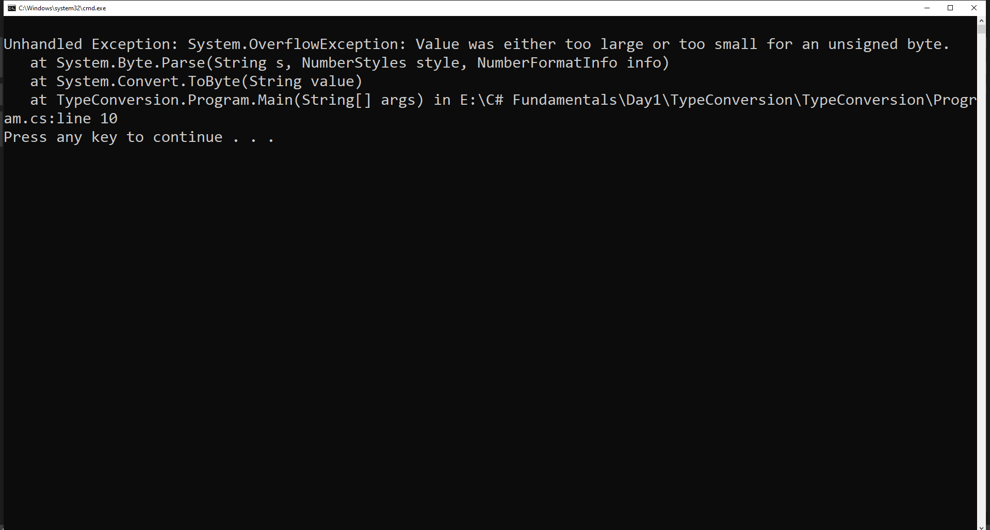


Slide 71
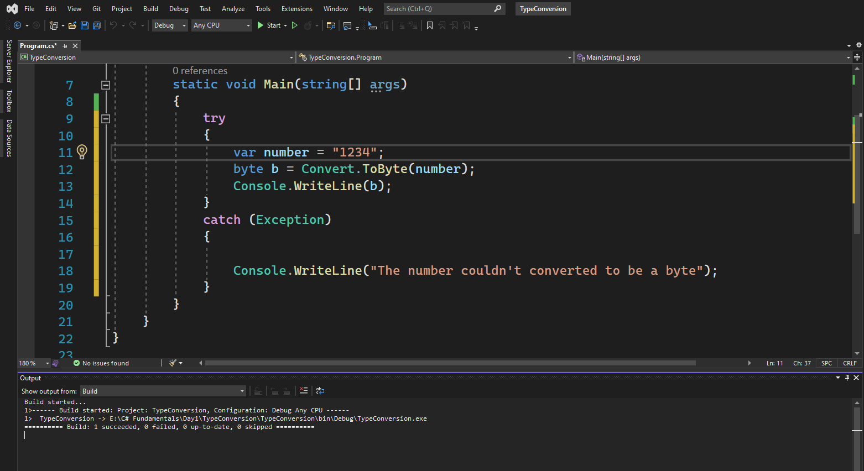

Slide 72
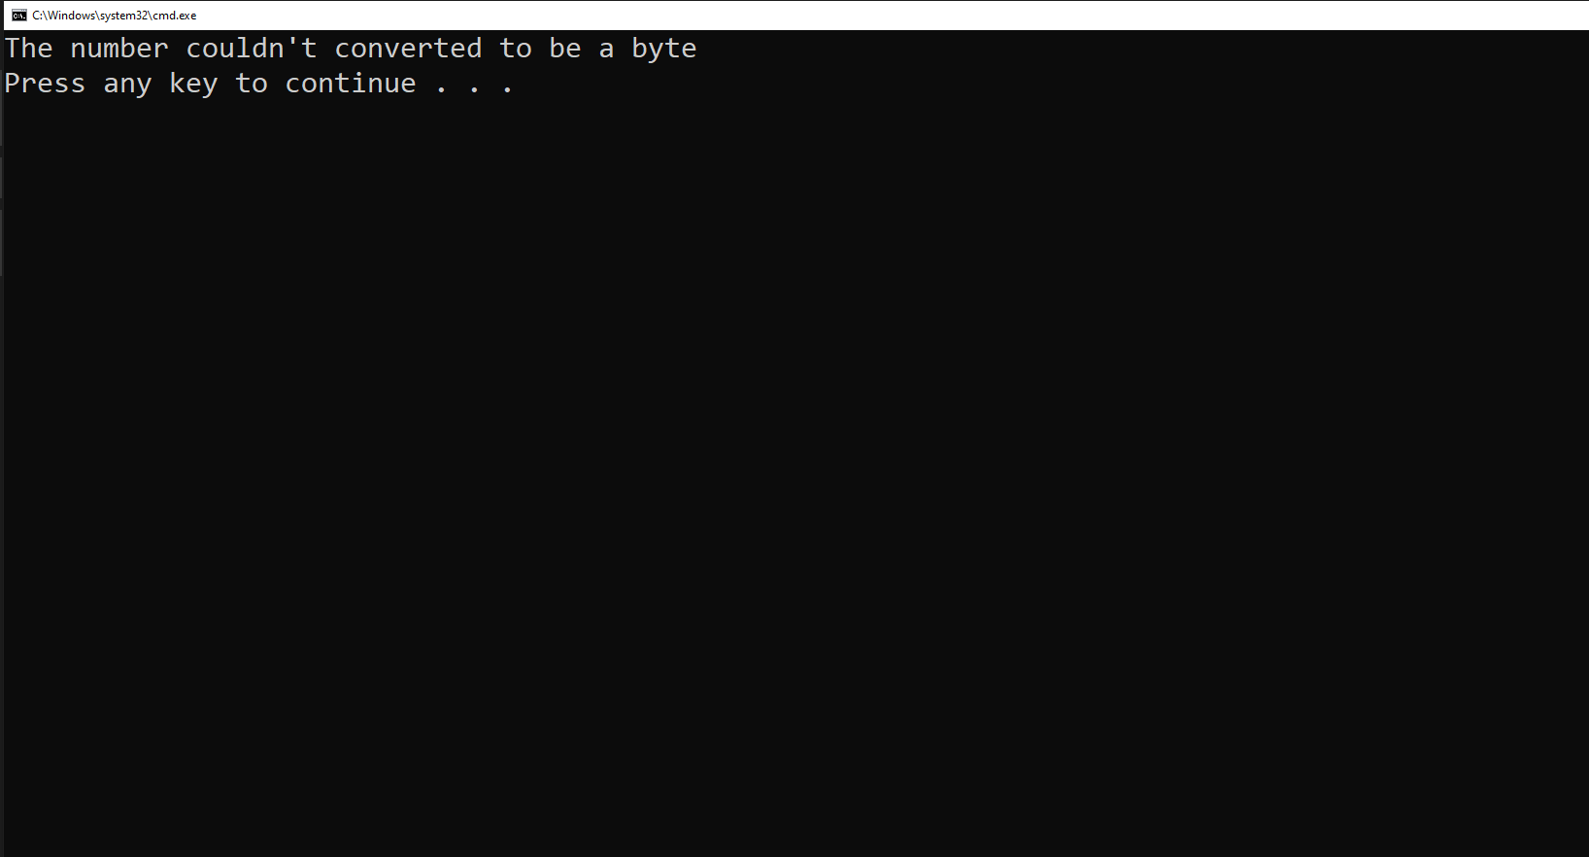

Slide 73
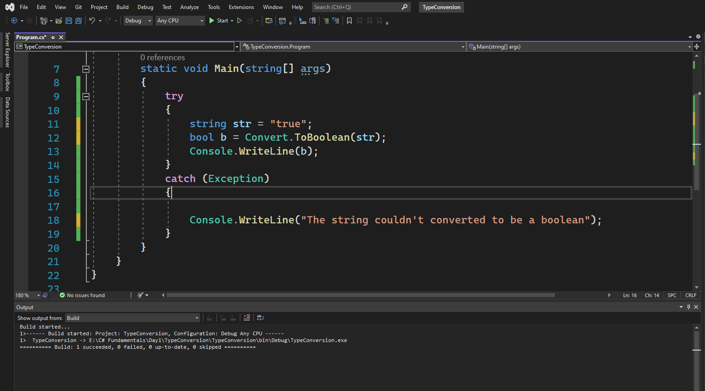

Slide 74


